Slide 1
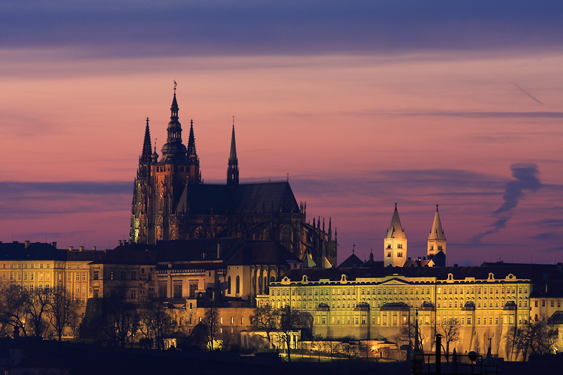
PRAGUE
Grandma of cities

Slide 2
Prague
Capital city of Czech Republic
In Prague live 1 200 000 people
Prague is a very historic city
There are many historical monuments in Prague
for example :the Charles Bridge, a Wenceslas Square, the Prague Castle, Astronomical Clock and the Old Town

Slide 3
The Charles Bridge
The Charles Bridge was founded by Charles IV.
Construction began on 9th of July in the 1357.
The Charles bridge replaced the earlier Judith Bridge
under the Charles bridge flows river Vltava

Slide 4
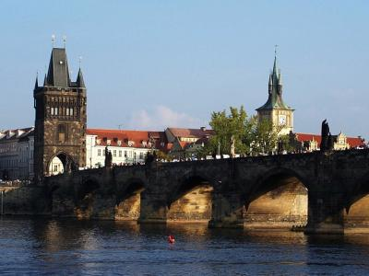
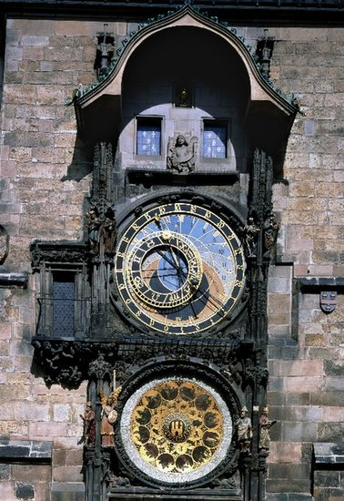
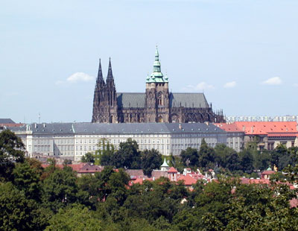
PICTURES OF PRAGUE – Astronomical Clock , The Charles Bridge , Prague Castle

Slide 5
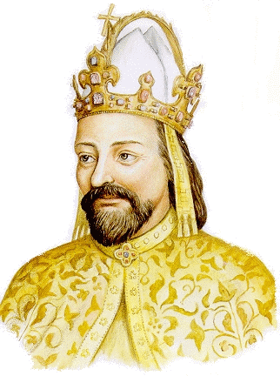
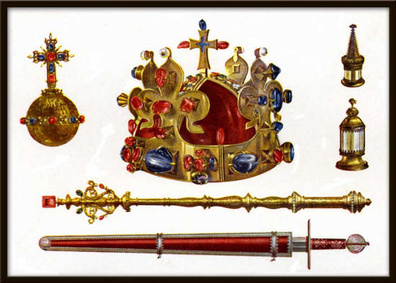
CROWN JEWELS

Slide 6
MADE BY :
Lucie Březinová 12 years old
Eva Vondráčková 12 years old
Elementary school Hlavečník

